Slide 1
Influencing Government
Evaluating Propaganda Techniques

Slide 2
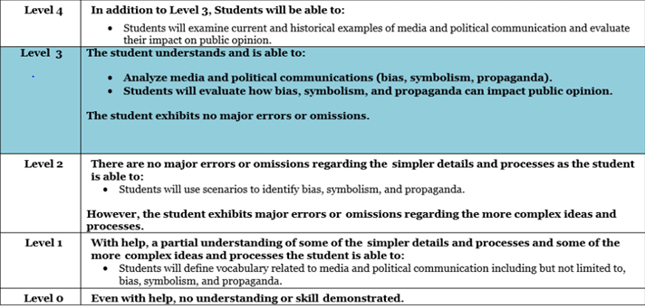
Today’s Goal
I will understand the rights and responsibilities of US citizens and analyze media and political communication for bias symbolism and propaganda.

Slide 3
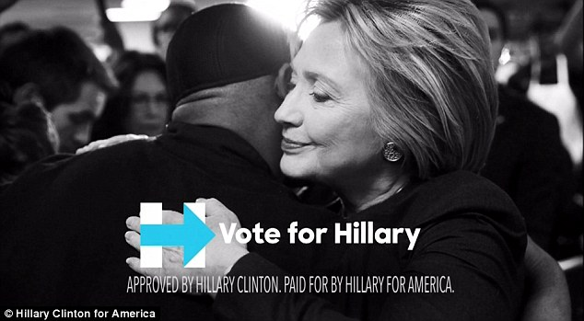
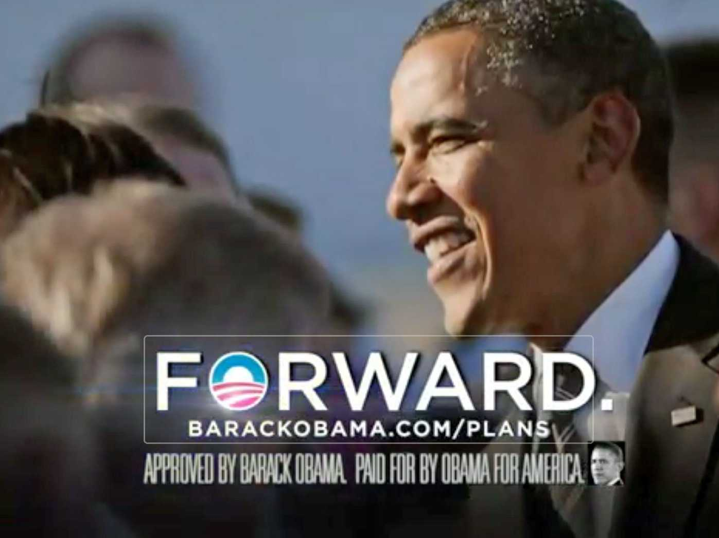
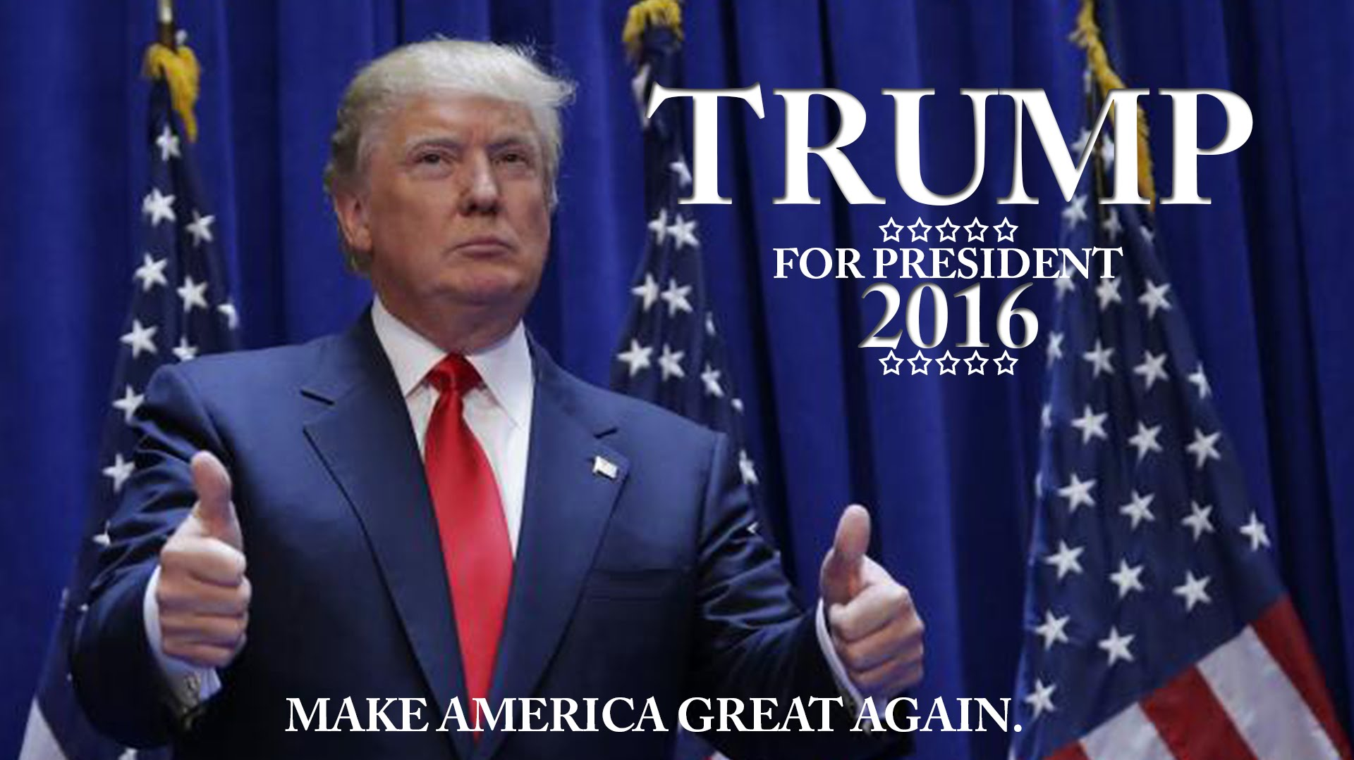


The Use of Media in Elections
Political candidates often use media outlets as a means of campaigning during elections. We saw an increase in the use of social media in the last election, especially.
Voters have to be aware of the various propaganda techniques that exist in order to make informed decisions on Election Day.
Today, we will examine different types of techniques that exist and put your knowledge to the test.

Slide 4
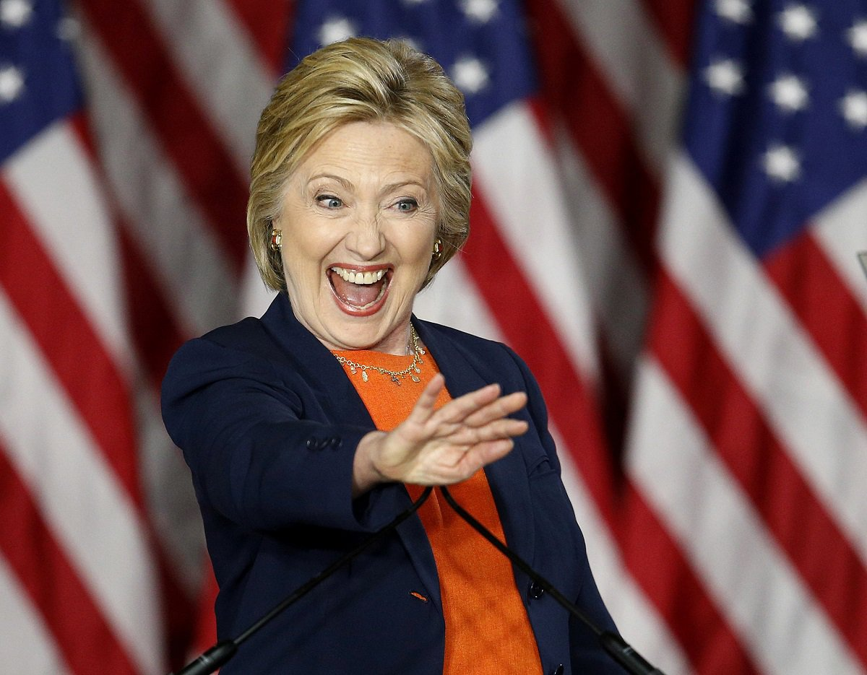

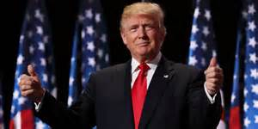
#1: Cardstacking
Cardstacking is a technique that is used to highlight only the very best features of a candidate, law or product.
Cardstacking may only present “half-truths” and may omit certain information that would make a candidate, law or product look undesirable.
Often times, candidates will use cardstacking in their speeches to attempt to win more votes.
Can you think of an example of what cardstacking might sound like?

Slide 5
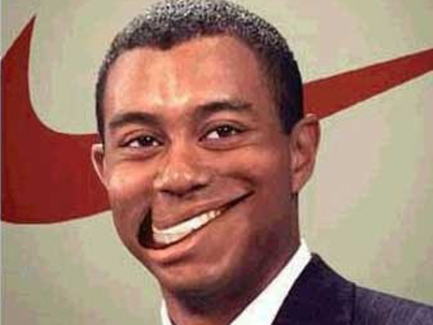
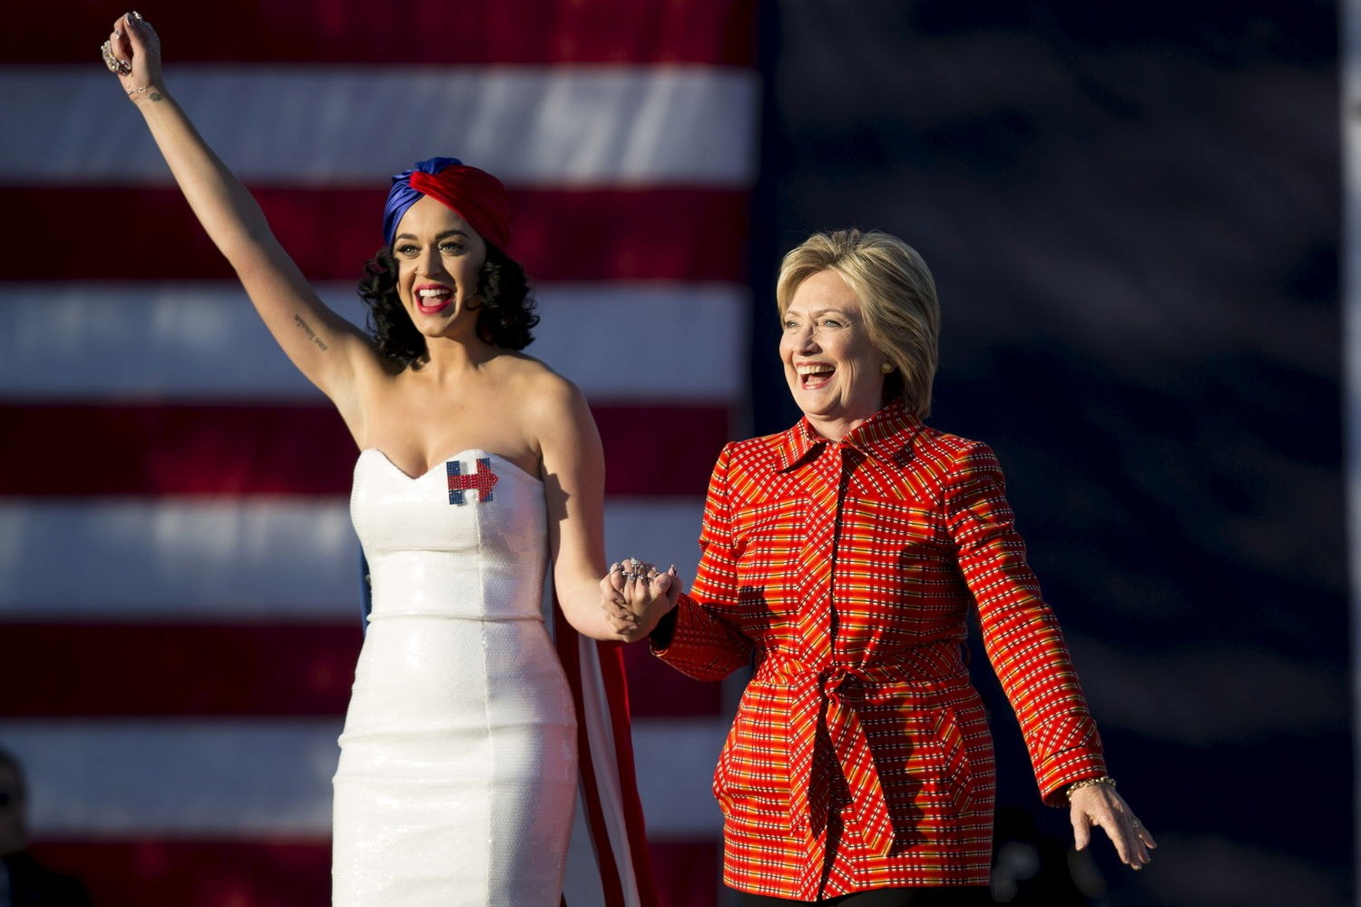

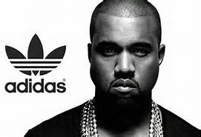

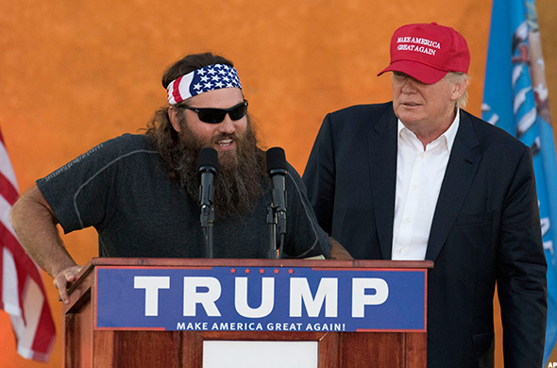
#2: Testimonial (Endorsement)
The testimonial strategy is exhibited when well-known, respected individual endorse (back up/show support) a candidate, product, service, etc.
Candidates/businesses will utilize endorsements to appeal to voter groups/consumers who may not generally vote for them/buy their product. This strategy helps generate support.

Slide 6




#3: Glittering Generalities
Strategy that uses words, ideas, or images that evoke a generally positive feelings and an emotional response from the audience.
“Warm fuzzies”
Political candidates might utilize this strategy to encourage voters to challenge their won virtues and values against the candidates that they are voting for.

Slide 7

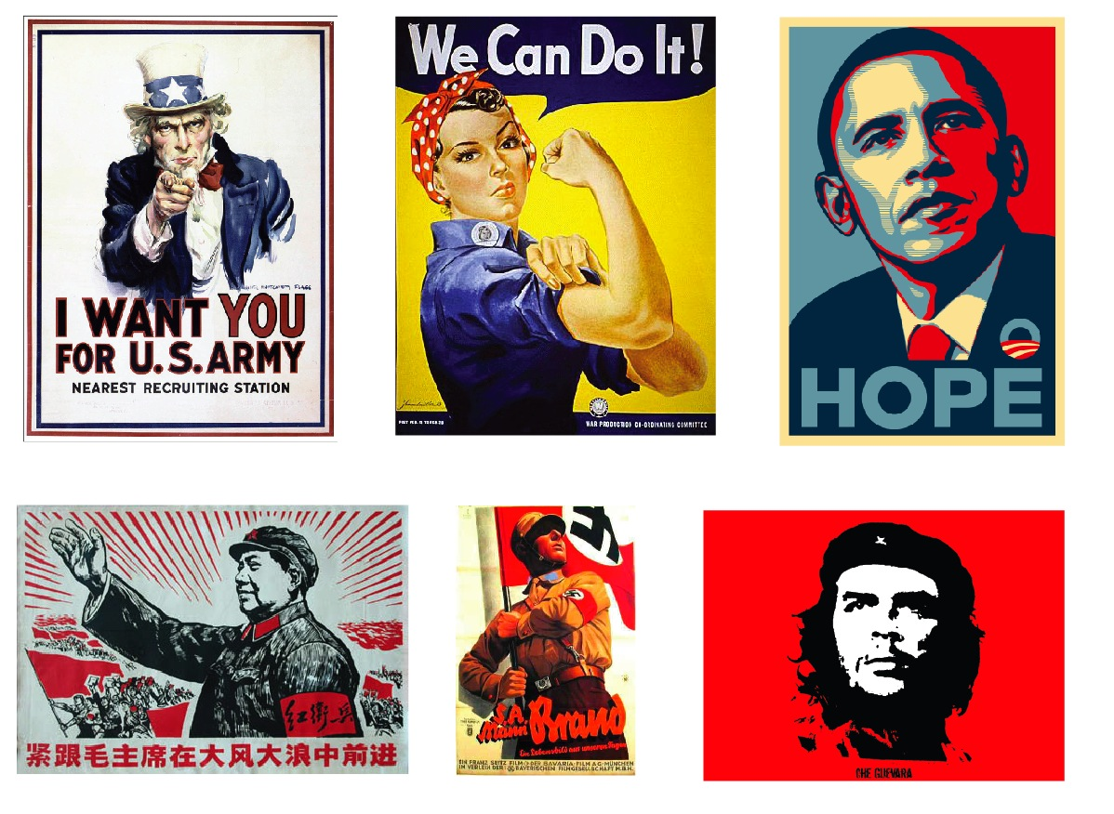
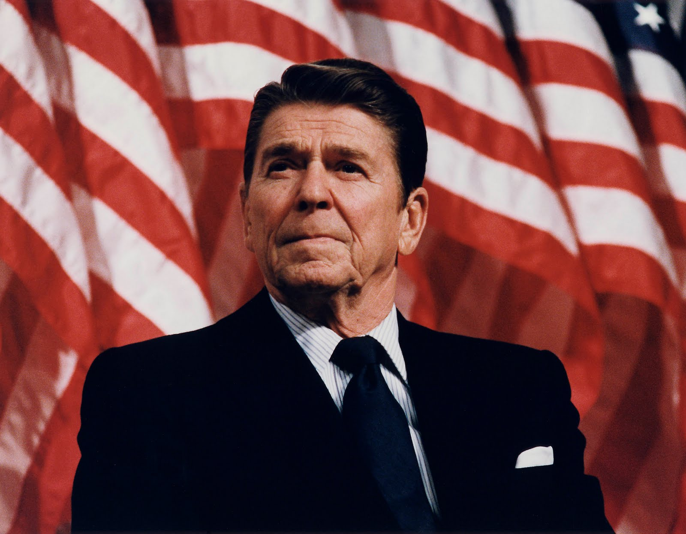

#4: Symbols
Also known as the “transfer strategy” – used to relate candidates/products with patriotic images and nationalistic colors, ideas, words, etc.
Candidates will wear American flag pins, businesses will utilize key words like “The American Way…”

Slide 8

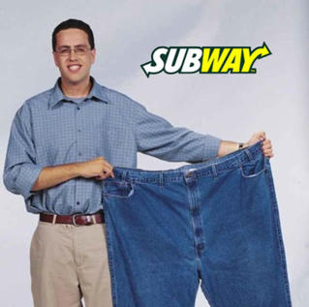
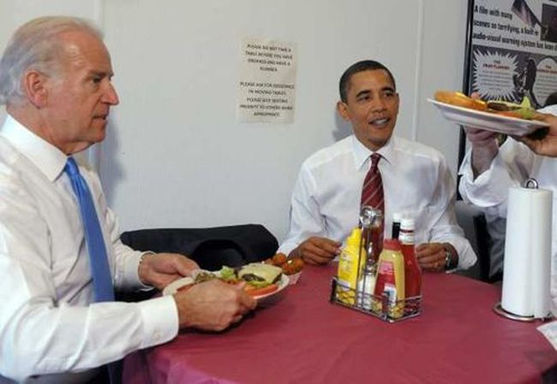

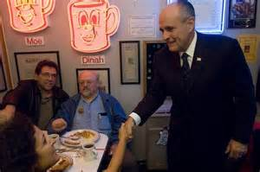
#5: Just Plain Folks
Plain folks is a strategy that utilizes everyday people to sell a product/candidate or a strategy that makes candidates feel like “one of us”.

Slide 9



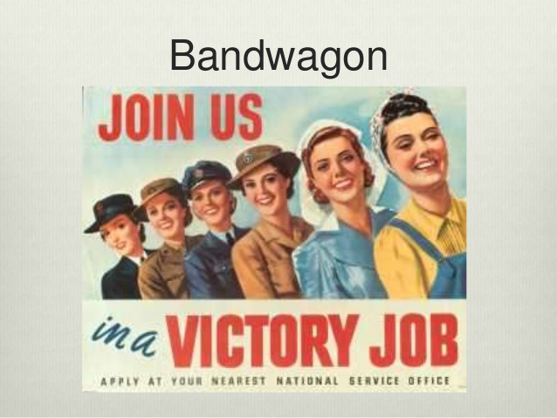
#6: Bandwagon
The Bandwagon strategy is any attempt to persuade the audience to take a course of action based on what “everyone else is doing”
Bandwagoning creates a “join the crowd” and “all the cool kids are doing it” mentality and persuades voters to take action accordingly.
This strategy appeals to people’s natural desire to be on the “winning team”.

Slide 10

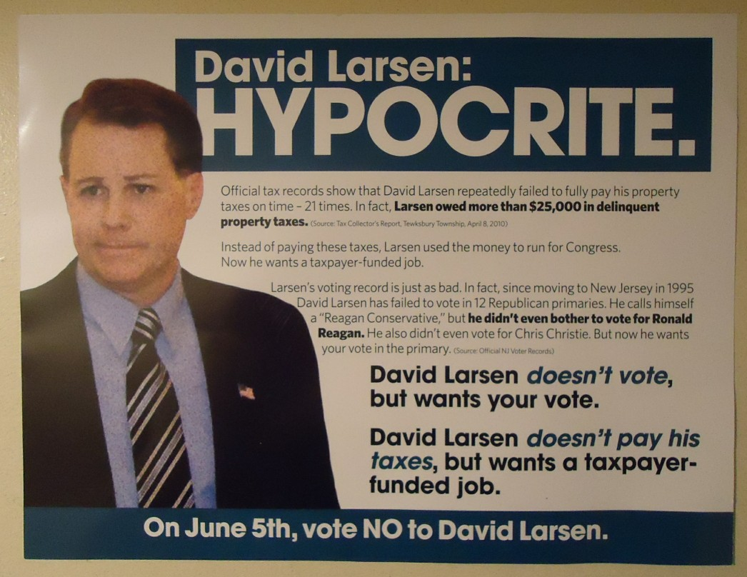
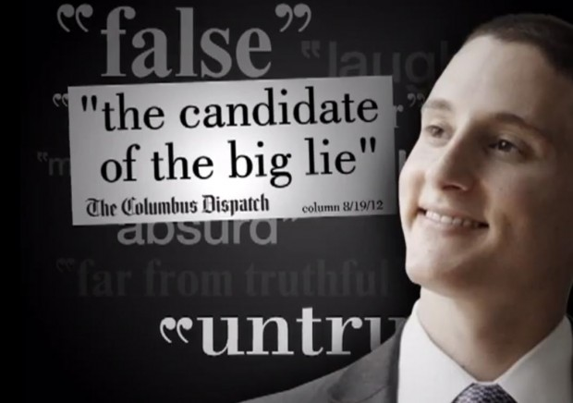

#7: Name-calling
Name-calling is a strategy that uses words, images, phrases to evoke fear, negativity, hatred, etc.
This technique is used to link candidates to a negative symbol.

Slide 11

Apply What You’ve Learned to
Real-World Situations!
Your group’s first investigative task is to view each ad while making a prediction regarding which propaganda technique is being used.
Then, you will provide supporting evidence that explains “why” you made that selection.
Next, your group will evaluate each ad for the use of symbols and bias. Be sure to complete the graphic organizer as you view each ad.
As a class, we will share in order to judge the validity of our predictions.
Finally, your group will use the new knowledge that you’ve acquired in order to create your own propaganda poster project demonstrating the technique your group has been assigned. Your poster should be used to draw new students to Lawton Chiles High School.

Slide 12
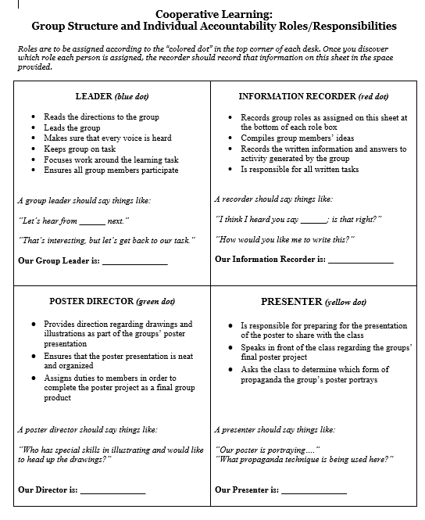
Poster Project Directions
Each desk has a sticker that corresponds to the role you’ve been “assigned” for the poster project.
As a group, read over the roles and brainstorm ideas for your project.
Tomorrow, we will work on creating our posters in class. Bring in any supplies or decorative items you’ll need to make your poster “POP!”

